Slide 1
The Toronto District School Board's Grade 9 Cohort and Post-secondary Pathways York-CASS Workshop, Toronto Robert S. Brown, York University/Toronto District School Board Paul Anisef, York University
Wednesday, May 27th, 2015

Slide 2
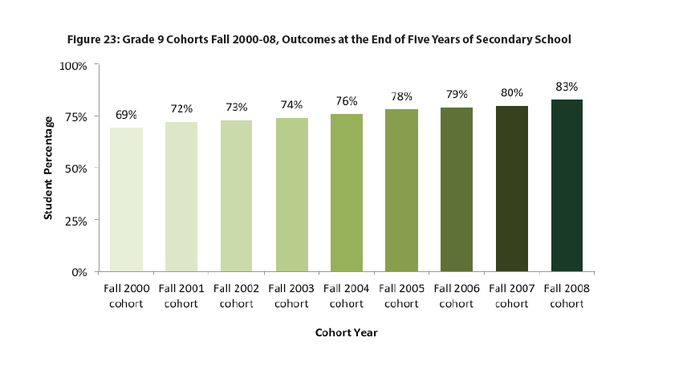
The Toronto District School Board (TDSB) Grade 9 Cohort 2006-11
After calculating for exit codes (students who are not in the TDSB), there were 16,365 students starting Grade 9 in 2006. As of October 31, 2011:
12,869 (78.6%) students had graduated;
1,193 (7.3%) were still in the TDSB; and
2,303 (14.1%) had dropped out (that is, according to our records, they had not graduated, were no longer in the TDSB, and had not transferred to another educational institution).

Slide 3
What is the Post-secondary Application Process?
Students applying to post-secondary institutions in Ontario provide applications through the Ontario Universities Applications Centre (OUAC) and the Ontario College Application Centre (OCAS).
We matched the 2010 applications with information in our Student Information System (SIS) for the 17-21 year old students in the TDSB as of March 31, 2011.
We looked at post-secondary applications over the 2010 and 2011 applications cycles (that is, Years 4 and 5 of the cohort). This is not the full picture of post-secondary - many students in the cohort will enter post-secondary in future years, as older adolescents or as adults.

Slide 4
What Characteristics and Challenges Influence this Pattern?

Slide 5
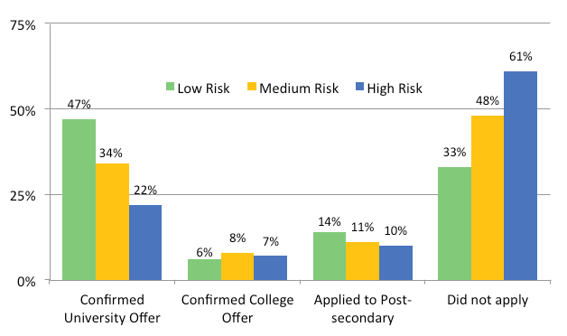
Early Development Indicators (Kindergarten) and Post-secondary Pathways
This is from a group of students who started two years later than this cohort.
It clearly shows that many students who are at risk in Kindergarten do not go to post-secondary.
However, most students who do not go to post-secondary are medium or low risk in kindergarten.
Source: The 2013-2014 Environmental Scan of the Toronto District School Board, p. 60

Slide 6
Special Education Needs: Grade 6
The vast majority of students without Special Education Needs in Grade 6 graduated (83%) and went to post-secondary (67%).
Most students with Special Education Needs (excluding Gifted) now graduate from high school, but do not go to post-secondary (e.g. of students with a Learning Disability, 64% graduated and 35% went to post-secondary.
One reason appears to be that students with Special Education Needs do not take Academic courses in Grade 9, which makes it difficult to attend either university or college.
Source: The TDSB Grade 9 Cohort 2006-2011: Special Education Needs - Fact Sheet No. 4

Slide 7
Grade 9 Achievement
Few students in the Grade 9 Cohort who achieved under 8 credits in Grade 9 confirmed university by the end of five years:
3% of those students with 6 or fewer credits,
13% with 7 credits,
59% with 8 or more credits by the end of Grade 9 confirmed university.
Most students who complete 7 credits by the end of Grade 9 will graduate with a high school diploma. The difference between 7 and 8 credits shows the difference between going on to university, and not doing so.

Slide 8
Academic Level, Gender and Age
Academic Level: 72.4% of students in Academic courses confirmed an offer of admission to post-secondary (university and college), while only 34.9% of students enrolled in Applied courses confirmed an offer of admission. Slightly more than three-quarters of students taking Locally Developed courses did not apply to post-secondary.
Conflict: Applied is supposed to be for students who want to go to college, but most college students took Academic.
Gender: 66.2% of female students confirmed an offer of admission to post-secondary, while 55.9% of males confirmed an offer of admission.
Age: Grade 9 Cohort students who are a year older are less likely to confirm an offer of admission to post-secondary when compared to age appropriate Grade 9 students (33.1% and 62.1% respectively).

Slide 9
Academic Level, Gender and Age

Slide 10
Racial Groups
There is a variation in post-secondary application rates within racial groups. Over 70% of Grade 9 Cohort students who identify themselves as East Asian confirmed an offer of admission to University. This is by far the highest compared to other racial groups.
Racial groups that had the highest percentage of confirmed admissions to post-secondary (university and college) included: East Asian, South Asian, and South East Asian (81.9%, 76%, and 68.3% respectively).
Racial groups that had the lowest percentage of confirmed admissions to post-secondary included: Latin and Black (38.7% and 41.4% respectively).

Slide 11
Region of Birth
Students born in Eastern Asia, South Asia, and Southern and Western Europe have higher percentages of confirmed admission to post-secondary (78.3%, 74.4%, and 70.5% respectively).
Students born in English-speaking Caribbean and South and Central America and Mexico have lower percentages of confirmed admissions to post-secondary (29.7% and 45.6% respectively).
57.9% of students born in Canada confirm an offer of admission to post-secondary. This is slightly lower than the overall percentage (60.9%).

Slide 12
Racial Groups and Regions of Birth

Slide 13
Student Language
In general, students speaking English (the largest group, accounting for just under half of the students) have confirmed admission to post-secondary results of 10% below the average (50.6% compared with 60.9%).
Students speaking Chinese, Bengali, Tamil, Hindi, and Guajarati have the highest percentages of confirmed admission to post-secondary.
Students speaking Spanish and Somali have the lowest percentages of confirmed admission to post-secondary.

Slide 14
Student Language

Slide 15
Parental Presence/Family Structure, Parental Education, and Parental Occupation
Parental Presence/Family Structure: Students with both parents at home are more likely to confirm an offer of admission to post-secondary (68.1%), when compared to students living with one parent or ‘other’ (49.4% and 50% respectively).
Parental Education: If parents have attended university, their child is more likely to confirm an offer of admission to post-secondary (72.6%), when compared to students whose parents did not attend university.
Parental Occupation: Parents’ occupation is used as an indicator of family socio-economic status (SES).
When comparing students’ post-secondary application results with their family SES, 73.1% of students with parents in a “Professional” occupation confirmed an offer of admission to post-secondary.
This percentage decreases as students’ SES decreases with 16.4% fewer students of parents with ‘non-remunerative’ occupations confirming an offer of admission to post-secondary.

Slide 16
Parental Presence/Family Structure, Parental Education, and Parental Occupation

Slide 17
Sexual Orientation
Heterosexual students are more likely to confirm an offer of admission to post-secondary than LGBTQ students (64.1% and 48.7% respectively).

Slide 18
Next Steps
Trajectories of Grade 9 credit failure: Most students who do not pass a key Grade 9 course in Grade 9 (Mathematics, English, Science, Geography) do not go to post-secondary. Why is this?
Extending the analysis of this cohort from October 31, 2011 to October 31, 2014: This provides the full picture of the direct transition from secondary to post-secondary.
Follow former TDSB students through college (including adults).
Analysis using the prism of Intersectionality, e.g. race plus gender plus income (see attached Fact Sheet).
The Gateway Cities project: comparing results of key Gateway cities including Toronto, Chicago, Vancouver, Dallas-Fort Worth, and London UK.

